Slide 1

NBA Player Stats Analysis
Presented by:
Prince Kumar(236302003)

Slide 2
Motivation
This project analyzes NBA player stats for the 2022-2023 season, aiming to reveal:
- Performance trends among top players
- Player Contract and Salary Decisions
- Predictive potential for player performance in upcoming seasons
Game Outcome Prediction

Slide 3
Problem Breakdown
The analysis process was divided into key steps:
Data Collection & Preprocessing
Data Cleaning & Transformation
Exploratory Data Analysis (EDA)
Statistical Analysis

Slide 4
Pseudo-Code Overview
# Main Program
file_path = "NBA_Player_Stats_2023_2024_Playoffs.csv"
1. Load data using NBADataLoader
2. Fill missing values and add RPG column
3. Initialize NBADataAnalysis with cleaned data
# Menu for User Interaction
While True:
• Show options:
Display column descriptions
Data summary
Top players by stat (user input for stat and number
Distribution by category (Position)
Average stats by team
Correlation matrix
Average stats by age
Shooting efficiency
Team performance
Team stat summary (user input for stat)
Display top players table
Display team points table
• If choice == 0: Exit program
• Else: Execute selected function
# NBA Data Loader
class NBADataLoader:
• Initialize with file_path, encoding, delimiter
• Load data using pd.read_csv
• Check for nulls and data types
• Fill missing values for percentage columns
• Add RPG column as sum of ORB and DRB
# NBA Data Analysis
class NBADataAnalysis:
• Initialize with data
• Display data summary (first rows)
• Show column descriptions (statistical meanings)
• Plot top players by specified stat
• Plot distribution by category (e.g., Position)
• Plot average stats (PTS, AST, RPG) by team
• Plot correlation matrix for numerical columns
• Plot average stats by age
• Plot shooting efficiency (3P% vs 3PA, FG% vs FGA)
• Plot team performance (average PTS, AST, RPG)
• Display team points table sorted by total points

Slide 5
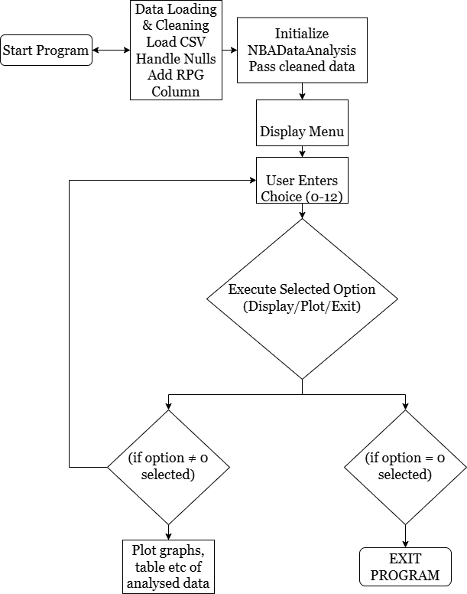
Flowchart:-

Slide 6
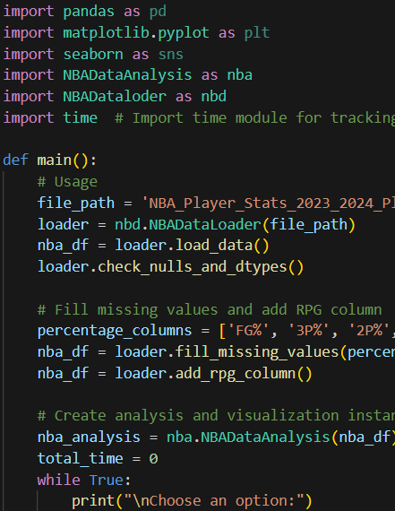
Pythonic Features
Pandas:-
Pandas is a powerful Python library for data manipulation and analysis, providing data structures like DataFrames and Series for handling structured data.
Numpy:-
NumPy is a powerful Python library for numerical computing, providing support for large, multi-dimensional arrays and matrices, along with a collection of mathematical functions to operate on them.
Matplotlib:-
Matplotlib is a comprehensive Python library for creating static, animated, and interactive visualizations in various formats.
Classes:-
The NBADataloader class handles the loading and preprocessing of NBA datasets, preparing data for analysis. The NBADataAnalysis class provides tools to explore, visualize, and analyze NBA player and team performance statistics.

Slide 7
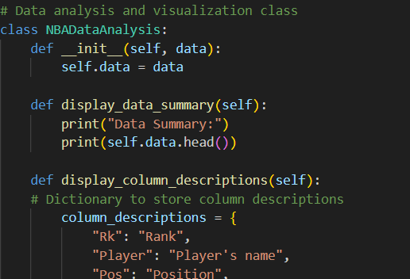
Pythonic Features
Loops:-
Loops in this project are used to iterate over the dataset for processing and analyzing multiple NBA player stats, ensuring efficient data handling.
Functions:-
Methods and functions in this project are used to encapsulate specific tasks like data loading, statistical calculations, and plot generation, enhancing code reusability. They streamline the analysis process by performing operations on datasets and returning useful insights or visual outputs.
Conditional operators:-
Conditional operators in this project are used to implement decision-making logic, such as filtering data based on specific criteria or evaluating player performance. They enable actions like team selection or data visualization adjustments depending on conditions like scores or game outcomes.

Slide 8
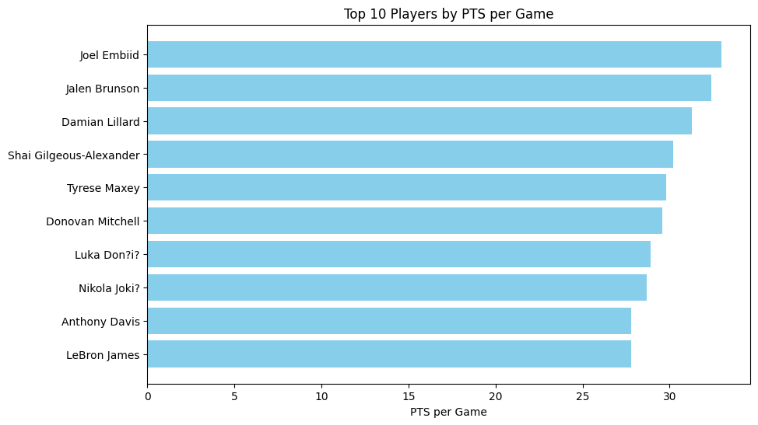
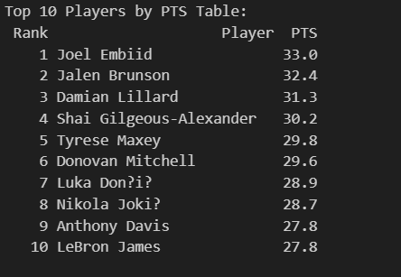
Results:-

Slide 9
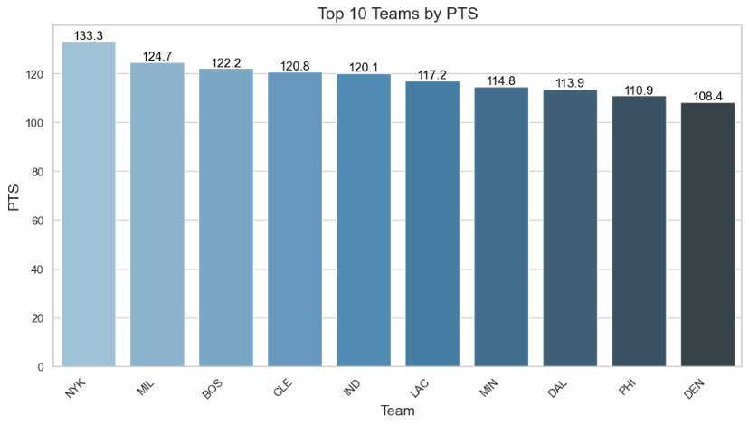
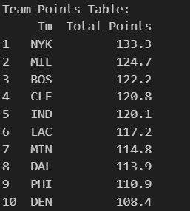
Results:-

Slide 10
Observations and Insights
Joel Embiid ranks 1st with an average of 33.0 points per game.
The New York Knicks (NYK) are ranked 1st with a total of 133.3 points.
The program takes approx 25.87 seconds to call all the if else statmetnt(1-12) once
Future Works
Integrate machine learning models to predict player performance and team outcomes using historical and real-time data.

Slide 11
Thank You!

